Slide 1
Look, Over There, Your Permissions Are Showing!
Fast, effective permissions auditing

Slide 2

Who Am I?
Travis Page, CISSP
Currently: Sr. Database Consultant at Hexagon
Over 10 years of experience as a DBA
Experience with both production database workloads in both AWS and Azure
Co-lead of the Pinellas SQL User Group
Butler to 3 cats, and bearer of thumbs

Slide 3

Legal Disclosure
My lawyers want you to know…
Notes:
I do not speak on behalf of my employer. Nothing in this talk should be constituted as legal advice. Always discuss any security or permissions related concerns with your internal security, legal and/or compliance teams to ensure that you get industry and company specific guidance.

Slide 4
What are we here to learn

Slide 5
At the end of this session you should:
Be able to provide a set of PowerShell commands that will output all permissions assigned to a server
Be able to identify red flags in an audit output and describe why these are potential risks to the organization
Be able to describe the SQL Server permissions model
Be able to describe how a login is associated to a SQL Server credential
Be able to determine if a SQL Server credential has a risk caused by nested membership (Active Directory or SQL Server Role)

Slide 6


What do your permissions look like?
Notes:
Does your environment have a hidden dumpster fire of permissions? Or are you sitting pretty with a hardened environment? How would you know?

Slide 7

Scenario
Your boss is asking for a report on who has access to the production systems. You have one hour, GO.
Notes:
This talk deals with a specific scenario some of us may find ourselves in at some point. We may be new in the DBA chair and we need a quick lay of the land. An audit may be active and we need results fast to comply with our compliance teams requests. There is always the possibility that we could be facing a security incident and we need to determine the scope. Being able to efficiently gather these answers and digest the data is a critical need for DBAs in today’s security minded culture.

Slide 8
What would your first instinct be?
Write a query to pull the data together
Use the SSMS UI to gather all of the permissions
Script out of all of the permissions and grep the output
Notes:
For some of us when we get the request for an audit of the permissions of our environment this can seem like a daunting task. Will I need to write a query to pull all of this data? Worse, would I need to go through the SSMS GUI and go to each login and user and make a note of their access? Would I need to formulate some kind of csv wizardry and use a tool like grep to find the permissions I’m auditing in the file to answer the question?

Slide 9
In dbatools we trust
Dbatools contains two cmdlets that can audit permissions
Get-DbaPermission
Get-DbaUserPermission
For this presentation I will use Get-DbaUserPermission
I will also be utilizing an additional module, ImportExcel to allow quick analysis within Excel
All scripts used are available on the SQLSaturday site, including the audit Excel output file
Notes:
Fortunately, we don’t have to do any of those painful tasks. We can simply stand on the shoulders of giants before us and us the painful lessons they’ve learned to help us in our environments. With the dbatools module we can quickly and easily automate our audit and return the results to our screen. Taking it a step further, with the ImportExcel module added to the mix we can provide a single file source of truth about our permissions in our entire server footprint in short order.
For reference, the Output-AuditResults.ps1 file contains the script used to generate the Excel file that contains all of the audit data used throughout the remainder of the presentation.

Slide 10
Beginning the Audit

Slide 11
Beginning Our Audit
Prerequisites
dbatools Module Installed
ImportExcel Module Installed
With this module this eliminates the need for the Office Suite to be present where the script is run
The output file can be saved and analyzed on a client workstation at a later time
Run Audit Script and pipe to Export-Excel
Notes:
We need to ensure that dbatools and ImportExcel have been installed before we can begin our audit.
Again the audit script can be found in the downloads, the file is labeled Output-AuditResults.ps1

Slide 12
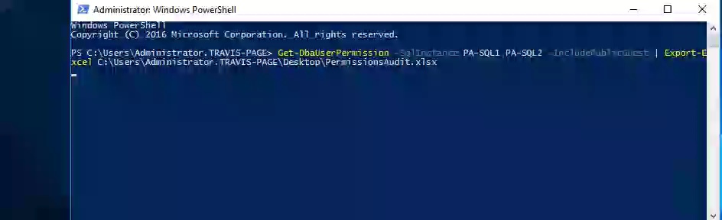
Fire Up The Audit

Slide 13
What is the format of our Excel file?
ComputerName
InstanceName
SQLInstance
Object
Type
Member
RoleSecureableClass
SchemaOwner
Secureable
GranteeType
Grantee
Permission
State
Grantor
GrantorType
SourceView

Slide 14
So how do I read this file?
Use a risk mindset and think like an attacker
If I have X privilege, what is the most damaging thing that I can do
Once you have worked through the assessment phase you have likely landed on one role or permission above all others
Notes:
I begin parsing the output with the most dangerous permissions first. I look at sysadmin and the other server level roles first as these can be the most destructive for availability. From here I look at the database level roles beginning again at the most destructive first, and with the most sensitive databases first. This may be more difficult if you have not completed a data classification exercise as you may not know for certain where your most sensitive data resides. Somewhere between the server level roles and database roles I will examine the SQL Agent roles, along with other SQL Server permission controls such as SSISDB, and SSRS that exist at the relational database level. This area requires some buy in as it often requires workflow changes and may break routines in the short term to buy long term security. Bottom line, make sure you have senior management and compliance buy in to your plan of attack. They will be your advocates with the development teams and will help facilitate a productive conversation.

Slide 15
What did we just gather?
Starting from the most granular and working our way inward
We can identify our server level permissions and any AD/local group assignments
We can identify our database level permissions and any AD/Local group assignments
Using the same audit technique we can identify the same identities used and the permissions assigned

Slide 16
SQL Server Permissions Model Overview
Notes:
Change gears for a few minutes to ensure everyone understands the permission model and areas of common misconceptions.
Server Level Permissions – Top level controls, typically high level controls around security objects (authentication, audit, process related controls, endpoints, linked servers, hadr, creation of databases, etc)
Database Level Settings – Isolated to a specific database at a time, controls are (authentication, audit, object access, backup access)

Slide 17
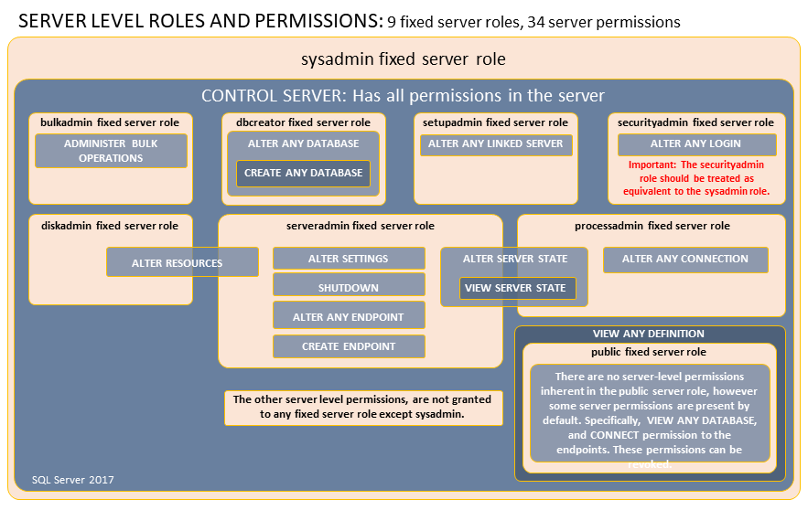
Fixed Server Roles
Notes:
Server level permissions control access to log in to the server in the case on non-contained databases. These permissions also grant significant control over how the SQL OS functions and allow major changes to be made, including possible denial of service, authentication method changes, trace flag changes, login changes, database creation/destruction, bulk operations, etc. Extreme care should be exercised over the sysadmin, securityadmin and control server roles, with other roles being important in other ways.
Typically I focus on sysadmin and securityadmin on my first pass with Control Server as an honorable mention. The other roles are very powerful in their own right but are less critical vulnerabilities.

Slide 18
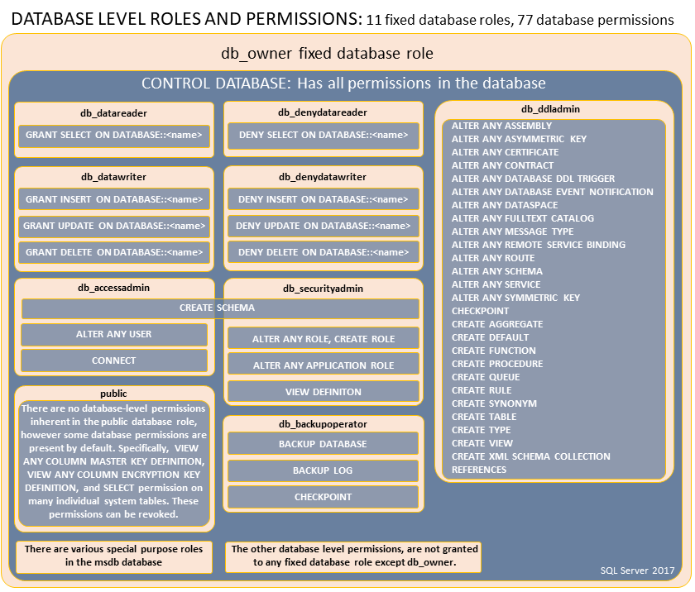
Database Level Roles
Notes:
Database level roles grant blanket access to a particular class of securable. These are often used in cases where granular object level permissions have not been identified, or schema level security has not been implemented. Granted roles should be scrutinized to ensure the minimal permissions required have been granted. This could be difficult to pair back if an application has been around a long time in the environment however, the first step is identifying this as a vulnerability.

Slide 19
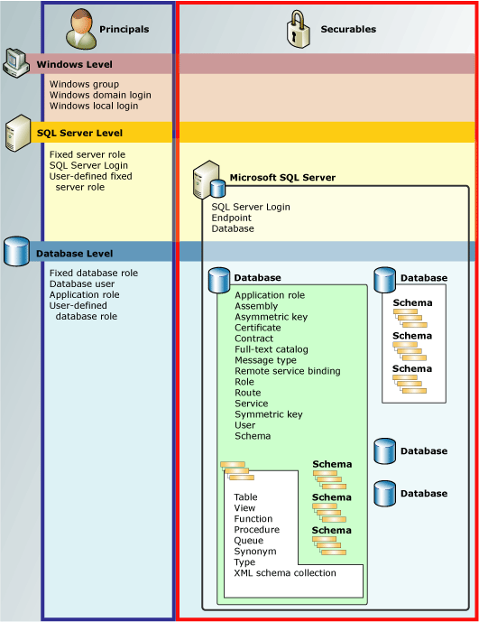
Permissions Hierarchy

Slide 20
Fixed SQL Server Agent Roles
Three roles are available
SQLAgentUserRole
SQLAgentReaderRole
SQLAgentOperator
The Roles Are Aligned As Shown
…Operator
…UserRole
…ReaderRole
Clarifying misunderstandings of the permission model
Notes:
This is an area I have found to be commonly misunderstood. The permissions of SQL Server Agent are concentric which can be observed by looking at the internal role assignments. Each inner role is a member of the outer role, until you reach Operator which has the most permissions. This role should be granted with care as this grants access to utilize any proxy present on the server. The common predicament is that development or support personnel need access for troubleshooting of Agent Jobs, however the dictate has been that no one shall own their own jobs. This is well intended as this prevents a job from breaking when the Active Directory account is disabled, however, this also means that more privileges are needed in order to change the owner of the job. Should a bastion host system be present in the organization an audited account could be utilized as the mechanism of providing troubleshooting access. This account would have the non-repudiation issue covered through the audited account check-out process with no capability of viewing the password.

Slide 21
sysadmin
Keys to the kingdom

Slide 22
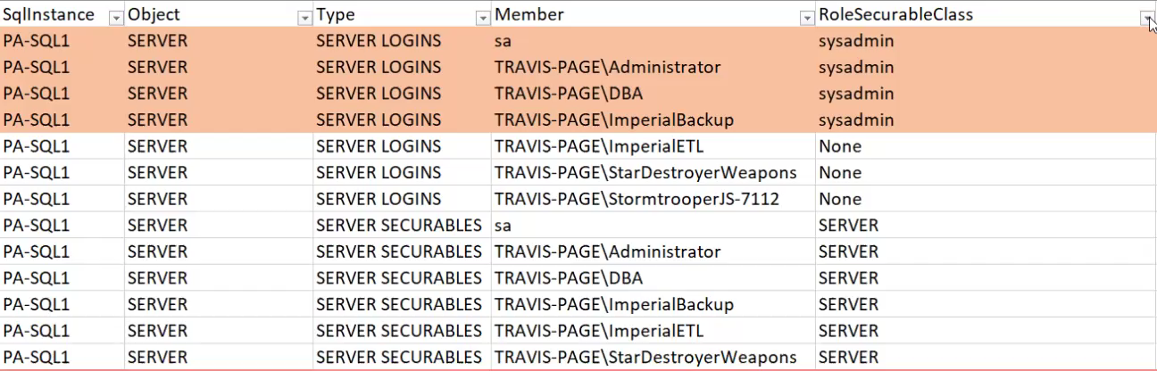
Identifying logins in sysadmin role
Notes:
Once we have our Excel file output in hand, we just need to run a sort and filter on the RoleSecurableClass to find our sysadmin logins. We will make a note of the following logins, sa and TRAVIS-PAGE\DBA as these will be referenced later. As an example, the TRAVIS-PAGE\Administrator was an artifact of the lab build, however, this is a domain admin account and could be a critical finding in an environment. Also of note is the use the group TRAVIS-PAGE\DBA as a sysadmin group membership across the fictional organization. This is a common practice in many organizations as a mechanism of ease of management, however this becomes an easy mechanism for a malicious employee to elevate their privilege and potentially steal data. Just like we segment our networks we should segment our groups so that if a group membership is compromised then the scope of risk is likewise segmented to a smaller pool of impacted services/computers/users. These high risk groups should also be audited as the churn in the group membership is likely to be small and easily monitored.

Slide 23
What Could An Attacker Do With This?
So sysadmin is bad, but what can we do with it?
Database Backups/Restores
Encryption Keys/Master Keys (Current/Historical Backups)
Full access to SQL Agent (Peristence)
Access to modify sp_configure (xp_cmdshell anyone?)
Create/Modify/Delete server audits
Create/Modify/Delete traces/extended events
Data Destruction/Exfiltration
Server Denial of Service or Destruction

Slide 24
Control Server
But I didn’t grant them sysadmin!

Slide 25
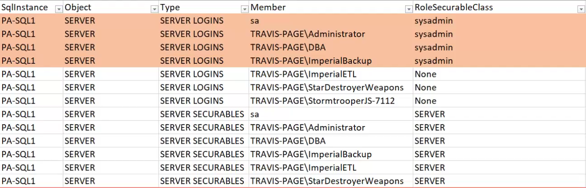
Identifying Control Server Permissions Granted

Slide 26
What Can An Attacker Do With This?
Wait, isn’t that the same as sysadmin?
In short, your server can be owned just as if you granted sysadmin, and all with a Metasploit module available: https://bit.ly/2Iohdzo
Subset of scary things
Impersonate ANY login
Kill ANY SPID
Create/modify traces
Create/Modify/Delete audit sessions
Create/Modify/Delete extended event sessions
Create/Modify/Delete credentials
Add/Modify/Remove Endpoints
Change UNSAFE ASSEMBLY setting
And more!

Slide 27
Impersonate
No really, I’m sysadmin

Slide 28
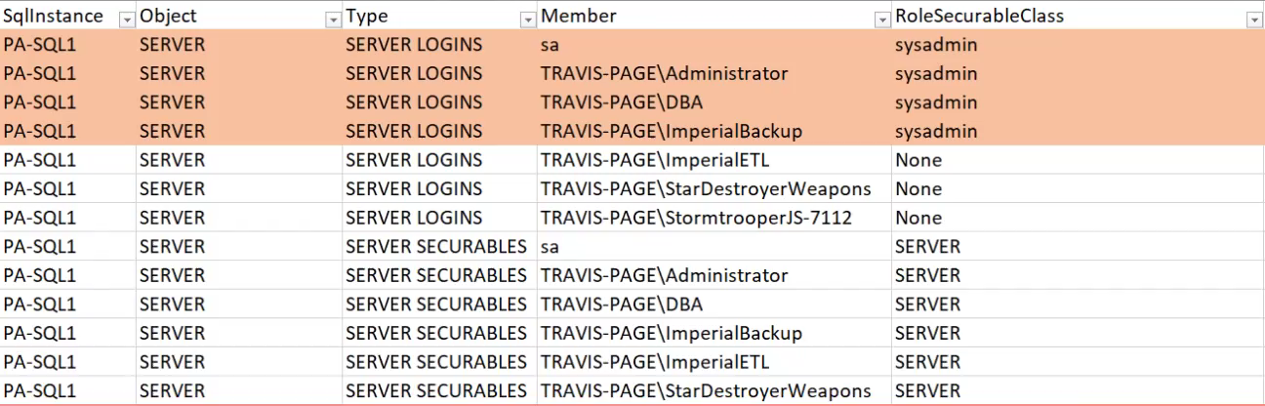
Identifying Impersonate Permissions Granted
Notes:
This is an interesting scenario. This demonstrates a web application being granted impersonate on sa. This may seem highly impractical, however, there is a Metasploit module in the wild that looks specifically for this misconfiguration.

Slide 29
What Could An Attacker Do With This?
This represents a sysadmin impersonation from a normal account
In short, the normal account gains full control of the server
All of the bad things a sysadmin can do with less visibility to the problem
Metasploit module available: https://bit.ly/2Iohdzo

Slide 30
db_owner
The easy button

Slide 31

Identifying db_owner Users
Notes:
Stormtrooper user represents an individual user that has been granted db_owner for unknown reasons
DeathStarPayroll has been granted db_owner for potentially legitimate reasons per the vendor but this warrants investigation

Slide 32
What Can An Attacker Do With This?
Subset of scary things
Backup/Drop Database
Change Database Encryption Settings
Change ANY Database Security Settings
Change ANY Database Object
Change UNSAFE ASSEMBLY setting
Inject CLR Object (Metasploit Module Available: https://bit.ly/2Z7tYoG)
Escalate Privilege (Metasploit Module Available: https://bit.ly/2KBdBNk)
Change ANY Database Audit Settings
And more!
In short, your server could be owned just as if you granted sysadmin if the conditions are right
Notes:
https://www.rapid7.com/db/modules/auxiliary/admin/mssql/mssql_escalate_dbowner_sqli
https://www.rapid7.com/db/modules/exploit/windows/mssql/mssql_clr_payload

Slide 33
db_ddladmin
I just wanted to be able to truncate that staging table

Slide 34

Identifying db_ddladmin Users
Notes:
We are demonstrating in this case that a developer has requested the db_ddladmin role for their ETL project which has legitimate need for truncate permissions on the staging tables. This role could result in ability to make damaging changes to live data if the live data exists in the same database. There could be legitimate usages for this, but this is a case where knowing the application is key. A better solution would be for the truncate routines would be to perform these via stored procedure and code sign the procedures with a certificate that has the appropriate alter table object permissions for only the required tables. This process means that the certificate is never capable of a login, but instead appends the permissions at runtime that it is assigned because it has signed the module.

Slide 35
What Can An Attacker Do With This?
Subset of scary things
Change ANY database object
Add ANY database object
Includes CLR objects
Inject CLR Object (Metasploit Module Available: https://bit.ly/2Z7tYoG)
In short, you could be exposing your database to potential data destruction and vulnerability
Notes:
https://www.rapid7.com/db/modules/exploit/windows/mssql/mssql_clr_payload

Slide 36
Public
Is it drafty in here?

Slide 37
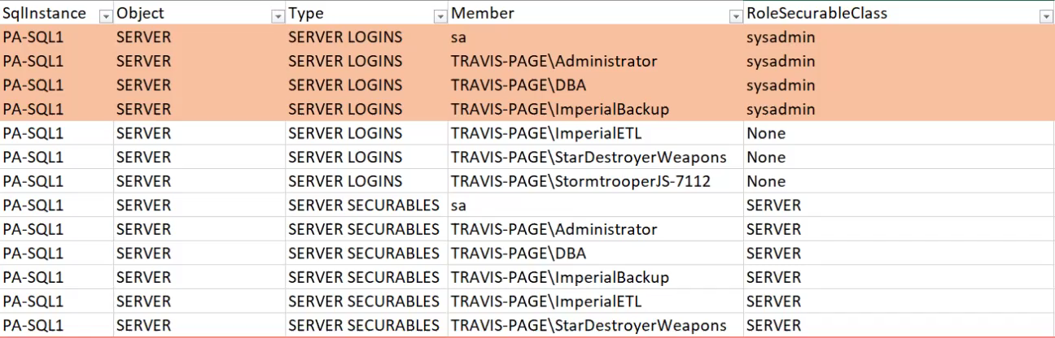
Identifying permissions granted to public
Notes:
This is another odd misconfiguration. By assigning permissions to public if a login and/or user exist with connect permissions to the database (login and user in the case of non-contained, user with connect in the case of contained) this would mean that they would be able to perform the action assigned. This could result in a very hidden method of escalating privilege.

Slide 38
What Can An Attacker Do With This?
This depends entirely on what is granted
This could be as simple as object access as shown
This could be as devastating as credential scaping such as what is demonstrated in this Metasploit module: https://bit.ly/2K6geab
Notes:
Module uses xp_dirtree and xp_fileexist which can be granted to the public role to expose the hash of the service account. These hashes can then be run through pre-computed tables to determine the credentials of the service account which could result cause the master keys to be exposed if they were backed up and restored to a new server.

Slide 39
SQL Agent Misconfigurations
Evidence of common misconceptions

Slide 40
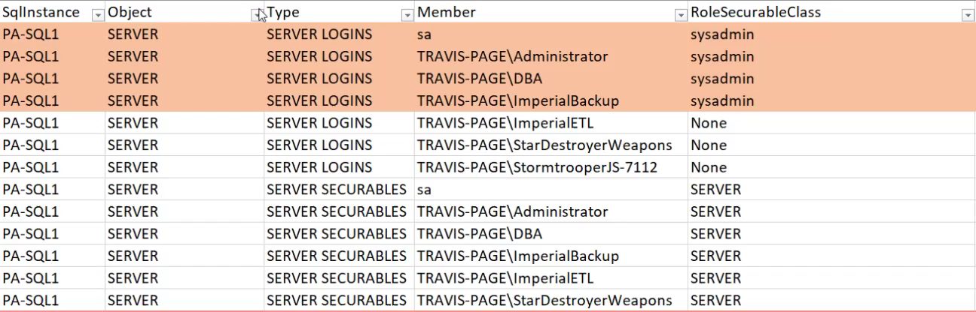
Identifying Common Misconfigurations of SQL Server Agent
Notes:
This commonly occurs when a DBA does not understand that each role is concentric. They are under the impression that the permissions function more like NTFS where each role must be assigned in sequence in order for things to work.

Slide 41
What Can An Attacker Do With This?
This is about common permissions misconception.
This should not be an immediate target for remediation as this is often harmless
This red flag appears correlated with other misconfigurations that will require investigation
Typically I look for this as a health indicator of the previous management of systems

Slide 42
Server and Database Role Nesting
More roles are better right?

Slide 43
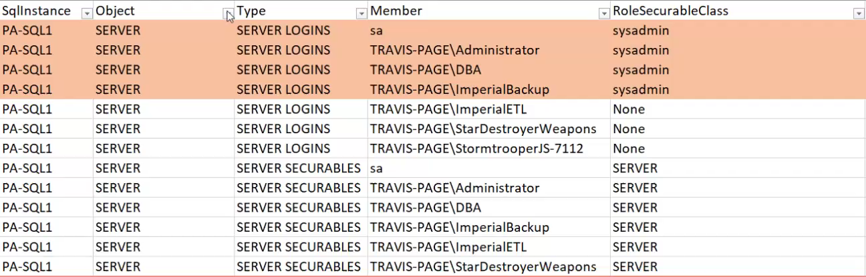
Identifying Nested Server or Database Roles
Notes:
This is a fun issue to troubleshoot. I have not had the opportunity to fully confirm, but it seems that somewhere between SSMS 17.9.1 and SSMS 18.0 this issue may have been partially resolved. The prior observed behavior was that nested roles would only show one level deep for the assigned permissions. If a role nested past one level (i.e. Nest1 → Nest2 → Nest3) then anything past level 2 would not display. This would result in missed permissions in the audit if performed through SSMS unless the roles were fully traversed to their root.

Slide 44
What Can An Attacker Do With This?
This misconfiguration is about administrative complexity.
By having nested roles tracking how a permission was assigned becomes harder
This results in less capability of performing an effective periodic access review and more exposure remaining
Unless a specific misconfiguration in the role nesting exists there will not be a vector for an attacker, but the risk will be elevated with this configuration

Slide 45
AD Groupception
Take the red pill and see just how deep the rabbit hole goes

Slide 46
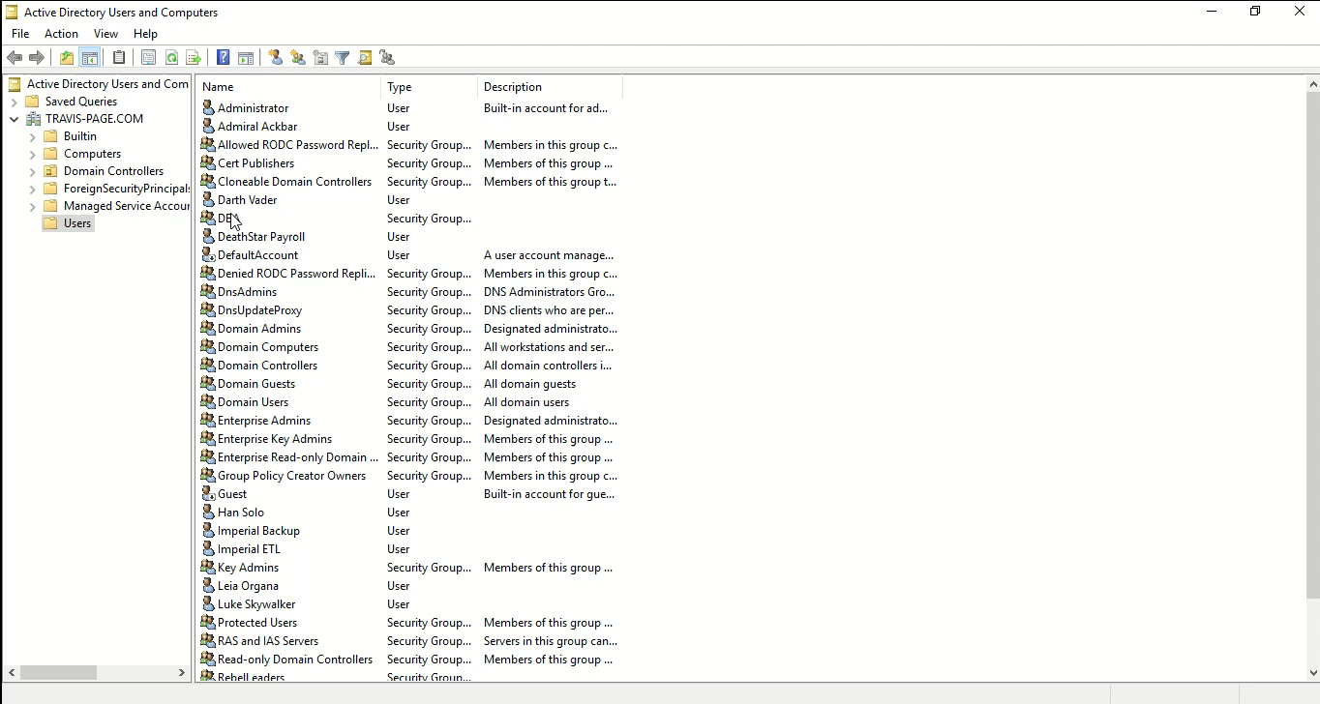
How to manually audit Active Directory Group Membership
Notes:
Much like the nested database roles, Active Directory groups can nest. Nesting in the case of Active Directory can be circular, and could be very deep. If you are looking at groups, especially in the context of your sysadmins you should always traverse these groups to their root and make a note of the full membership list. If this list is not correct this should be the first priority to correct.

Slide 47
What Can An Attacker Do With This?
Scenario 1
Active Directory group membership is wider than intended
This results in members having more access/rights than intended
A malicious employee in this group could prove damaging to organization reputation
Scenario 2
Active Directory group membership controls all sysadmin rights in organization footprint
Compromised account is added to this group and can then own all servers in entire organization

Slide 48
What else can I do with this?
Identify nested database roles
Troubleshoot permission issues
Identify permission drift with scheduled output
Compliance audits look for routine permissions audits, this can be used to automate a mundane task
Notes:
This can also be extended to include permissions for SSISDB and SSRS at the database levels as there are role based permissions involved with both of these products.

Slide 49
Conclusion
Basic permissions audits can be performed in minutes
Analysis of the results can help to uncover environmental issues
This analysis may take time, but there can be quick wins within hours
PowerShell can automate the dumping of permissions allowing for the DBA’s time to be spent in analysis

Slide 50
Questions?

Slide 51
Additional Resources
Database Engine Permissions:
https://bit.ly/2QSfl5G - SQL Server Permissions
https://bit.ly/2WrzgyB – Current Permissions Poster
Metasploit Modules:
https://bit.ly/2Irc0GZ - SQL Server related modules

Slide 52
Contact Information
LinkedIn: www.linkedin.com/in/travispage
E-Mail: travisp@travis-page.com

